Slide 1
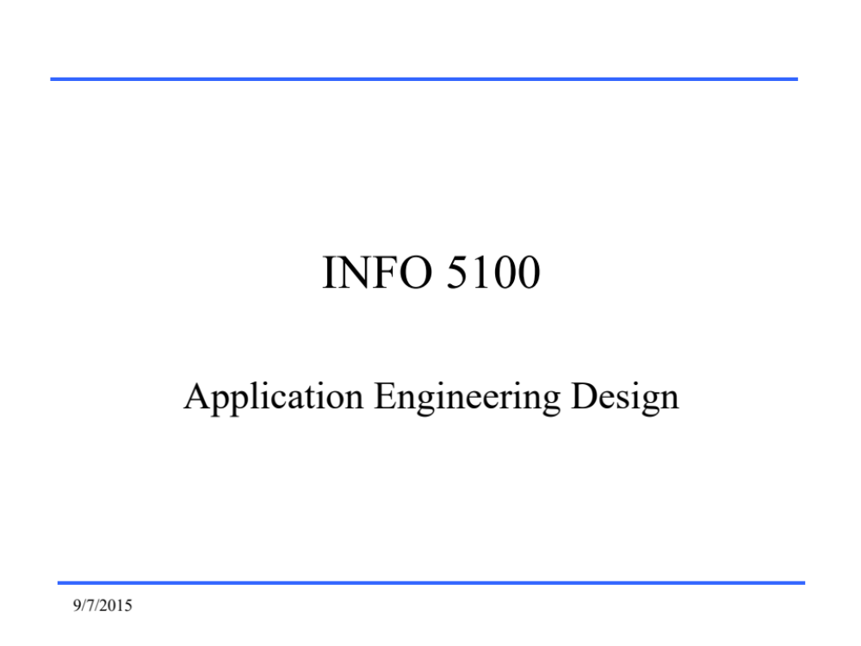
CSYE 6200
Concepts of Object Oriented Design
9/7/2015
Notes:
1/30/2017
Added Additional example of target classes to AbstractPerson example 1 including AbstractDrone example 2, AbstractRecv example 3 and AbstractSend example 4
Added Sngleton design pattern

Slide 2
Java GoF Factory Design Patterns
Daniel Peters
d.peters@neu.edu
9/7/2015

Slide 3
Lecture
  Singleton pattern
  Simple Factory Pattern
  Factory Pattern Method
2/10/2020

Slide 4
Design Patterns
Gang of Four (GoF) Book
Design Patterns
Elements of Reusable Object Oriented Software
by Erich Gamma, Richard Helm, Ralph Johnson John Vissedes
ISBN-10: 0201633612
ISBN-13: 9780201633610
9/7/2015

Slide 5
Singleton Design Pattern
Singleton Pattern is introduced in GoF Design Patterns Book:
  Ensure a class has ONLY ONE SINGLE instance and provide a GLOBAL point of access to it"
Abstraction: Functionality Hiding
  Abstracts Class Constructor
Used for Logging, Configuration, Factories
9/7/2015

Slide 6
Singleton Design Pattern
Private constructor is never used by caller
Public getInstance() method returns the one and only instance of singleton class
Singleton class insures that one and only one instance of itself is instantiated
Serves as a ‘better’ global variable
ALL GLOBALS ARE BAD
  Bad for multithreaded implementations
  Global access is problematic
9/7/2015

Slide 7
Simple Singleton Example
public class SimpleSingleton {
private static final SimpleSingleton instance =
new SimpleSingleton();
private SimpleSingleton() {
}
public static SimpleSingleton getInstance() {
return instance;
}
}
9/7/2015

Slide 8
Simple Singleton
Early or Eager initialization
Resource is always available
  Allocated From beginning of program execution
Resource immediately available without delay
    Real-Time Performance Benefit
Resource is allocated EVEN IF NEVER USED
    Can be a waste resources
9/7/2015

Slide 9
Lazy Singleton Design Pattern
public class LazySingleton {
private static LazySingleton instance;
private LazySingleton() {
instance = null;
}
public static synchronized LazySingleton getInstance() {
if (instance == null) {
instance = new LazySingleton();
}
return instance;
}
}
9/7/2015

Slide 10
Lazy Singleton
Late or Lazy initialization
Resource allocated WHEN REQUESTED
  Preserves resources until actually required
Resource NOT immediately available
    Allocation delay can be a Real-Time Performance Hit
9/7/2015

Slide 11
Singleton Example
public class OnlyOne {
private static OnlyOne instance; // data member
private OnlyOne() {
instance = null;
}
public static synchronized OnlyOne getInstance() {
if (null == instance) {
instance = new OnlyOne();
}
return instance;
}
}
9/7/2015

Slide 12
Singleton: Private Constructor
public class OnlyOne {
private static OnlyOne instance;
private OnlyOne() {
instance = null;
}
. . .
}
9/7/2015

Slide 13
Singleton: Public API
public class OnlyOne {
private static OnlyOne instance; // data member
. . .
public static synchronized OnlyOne getInstance() {
if (null == instance) {
instance = new OnlyOne();
}
return instance;
}
}
9/7/2015

Slide 14
Singleton design Pattern Usage
OnlyOne singletonInstance = null;
singletonInstace = OnlyOne.getInstance();
singletonInstance.toString();
9/7/2015

Slide 15
Simple Factory Pattern
Creational Design Pattern
  Abstraction: Functionality Hiding
    Abstracts Class Constructor
Employs Inheritance
  Superclass as basis
    Interface
    Abstract Class
Single Factory class creates an instance of a concrete derived target class
  Return instantiated target object to caller
9/7/2015

Slide 16
Simple Factory Pattern
NOT mentioned in GoF
Violates S.O.L.I.D. Design Principles
  Must be changed for new derived classes violating Open/Closed principle
Switching logic for criteria Complicates unit testing
9/7/2015

Slide 17
Simple Factory Pattern Components
Design ONE target Superclass
  API to Abstract all derived classes
    Example: Explosion
Design concrete derived target subclasses
  Example: GunShot, Grenade
Design one factory class
  Factory class instantiates ALL derived target subclasses based on supplied criteria AND SWITCHING LOGIC
9/7/2015

Slide 18
Simple Factory Pattern Usage
Instantiate Simple Factory class
Use “get object” method, supplying criteria for specific target
Method returns instantiated target object after switching logic to determine which concrete derived subclass meets criteria
9/7/2015

Slide 19
Simple Factory Pattern
public class SimpleExplosionFactory {
enum ExplosionCriteria {
GUNSHOT,
GRENADE
}
public Explosion getObject( ExplosionCriteria criteria ) {
if (criteria == instance) {
return new Gunshot();
}
return new Grenade();
}
}
}
9/7/2015

Slide 20
Usage Simple Factory Pattern
public static void demo() {
// Simple Factory: one factory creates all derived objects
SimpleExplosionFactory factory =
new SimpleExplosionFactory();
List<AbstractExplosion> explosions = new ArrayList<>();
explosions.add(factory.getObject(GUNSHOT ));
explosions.add(factory.getObject(GRENADE ));
explosions.add(factory.getObject(ABOMB));
}
9/7/2015

Slide 21
Factory Pattern Benefits
  Best for large projects with many developers
Provides Loose coupling
  Eliminates widespread hard coding of object instantiation
  Flexibility: Easy to change class implementation
  Robust: Supports Best Practices
    Code depends on Interface or Abstract class
    Less dependence on concrete classes
  Greater flexibility than constructor overloading
    Business case to limit instantiations
9/7/2015

Slide 22
Factory Anti-Pattern Detriments
  Anti-Pattern: Using patterns just to use patterns
    Usually a not a good fit and only adds complexity
Skip Factory Pattern
  Simple small project won’t benefit much
  Small group work little benefit
  No dependencies
  Few changes
  No Business logic
9/7/2015

Slide 23
Target Classes: example 1
AbstractExplosion Super Class
  Gunshot concrete target subclass
  Grenade concrete target subclass
  ABomb concrete target subclass
9/7/2015

Slide 24
Factory Pattern Method
Factory Method Pattern is introduced in GoF Design Patterns Book:
  Define an interface for creating an object, but let subclasses decide which class to instantiate. Factory Method lets a class defer instantiation to subclasses"
Creational Design Pattern
  Abstraction: Functionality Hiding
    Abstracts Class Constructor
9/7/2015

Slide 25
Factory Pattern Method
Employs Inheritance
Abstract class or interface as basis for target subclasses
  Just like Simple Factory Pattern
Abstract class as basis for Factory classes
  Creates instances of a concrete derived Factory subclasses
    Each Concrete derived factory subclass creates an instance of a concrete derived target subclass
    Return target object to caller
9/7/2015

Slide 26
Factory Pattern Method Components
Design target Abstract super class
Design concrete derived target subclasses
Design factory Abstract super class
Design concrete derived factory subclasses
  Each concrete derived factory class specializes in instantiating one concrete derived target class
  No SWITCHING LOGIC simplifies unit testing.
9/7/2015

Slide 27
AbstractExplosion
public abstract class AbstractExplosion {
public abstract void explode();
}
API for each derived object returned by a factory
9/7/2015

Slide 28
AbstractExplosionFactory
public abstract class AbstractExplosionFactory {
public abstract AbstractExplosion getObject();
}
API for each factory used to create a derived object
9/7/2015

Slide 29
Gunshot Factory derived subClass
public class GunshotFactory extends AbstractExplosionFactory {
public abstract AbstractExplosion getObject() {
return new Gunshot();
}
}
9/7/2015

Slide 30
Grenade Factory derived subClass
public class GrenadeFactory extends AbstractExplosionFactory {
public abstract AbstractExplosion getObject() {
return new Grenade();
}
}
9/7/2015

Slide 31
ABomb Factory derived subClass
public class ABombFactory extends AbstractExplosionFactory {
public abstract AbstractExplosion getObject() {
return new ABomb();
}
}
9/7/2015

Slide 32
Usage Factory Pattern
public static void demo() {
// Factory Pattern: each factory specializes in one derived objects
AbstractExplosionFactory factory1 = new GunshotFactory();
AbstractExplosionFactory factory2 = new GrenadeFactory();
AbstractExplosionFactory factory3 = new ABombFactory();
List<AbstractExplosion> explosions = new ArrayList<>();
explosions.add(factory1.getObject());
explosions.add(factory2.getObject());
explosions.add(factory3.getObject());
}
9/7/2015

Slide 33
Singleton Design Pattern Summary
Eager or Early Initialization:
  Resource allocated at program start before run.
  Waste of resource if never actually requested.
Lazy or Late Initialization:
  Resource allocated at run-time when requested.
  Conserves Resource until actually required.
9/7/2015

Slide 34
Factory Design Patterns Summary
Simple Factory Pattern
  Single Factory uses supplied criteria and switching logic to create one of several specific instantiated target subclasses
Factory Pattern Method
  Several Factories EACH of which can create A SINGLE specific instantiated target subclass.
Abstract Factory Pattern
  Factory for Factories
9/7/2015

